Slide 1
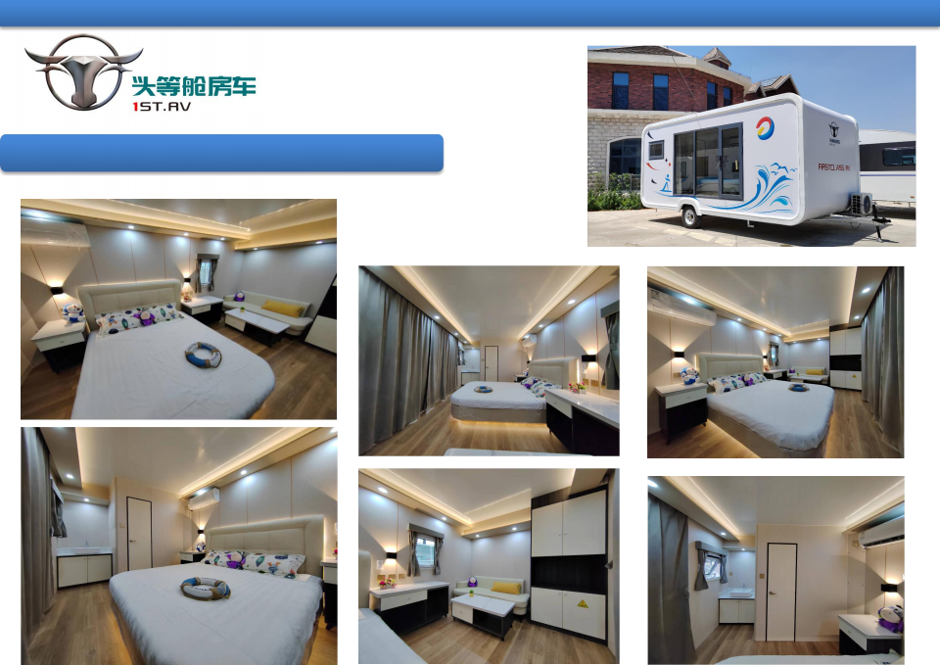
First / class / car Be / born / for / leading
The first-class trailer-mounted camp RV-7 meters Shangpin Apple Crysta (Big Bed)
Shan / dong / Shi / tuo / RV / Group / Co., / Ltd.

Slide 2
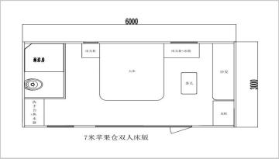
First / class / car Be / born / for / leading
The first-class trailer-mounted camp RV-
7 meters Shangpin Apple Crysta (Big Bed)
7 -meter apple cabin large bed version model
Basic parameters | Basic configuration
Vehicle model | ST8651G04-B1
physical dimension | 7300*3060*3260mm
Body length | 6060mm (without air -conditioning racks and traction racks) 6370mm (with air conditioning frame) 7300mm (with a leader)
Net size in the car | 5884*2884*2268mm
Interior space | 16.97 square meters
Number of bed shops | Double bed
Number of residents | 2
Vehicle equipment quality | 2820kg
Wheelbase | 4422mm
Number of a shafts | Single axle
Tire size | ST225/75R15
Way of travel | Traction
Brake | none
Chassis | Dalvation steel pipe welding
Furniture and interior configuration
Furniture | Light luxury style
Carriage material | Composite Sician Tan Board
the color of car | White
Body decoration | UV -resistant ultraviolet special car sticker
Furniture | E0 solid wood multi -layer board
Furniture decorative stickers | PVC membrane panel, pattern; vacuum suction attachment technology
Privacy curtain | have
floor | Brand floor
sofa | High -end leather sofa
Snursement upper and lower water road system configuration
bathroom | Wet and wet separation
Ceiling | Integrated ceiling
sink | Square -shaped washbasin
shower head | Brand shower
Shower room | Rock board+UV board with glass sliding door
Toilet | Ceramic smart toilet
Method of upper and lower water | External pressure water source, direct discharge
Electrical configuration
Power supply | External 220V power supply
Electricity collection | Plug in card
Power distribution control cabinet | Steel spraying
Light | Indoor lighting 220V
Water heater | Brand water heater 2000W/60L
Wind and warm bath | Brand Yuba
air conditioner | Air conditioner 1.5P
refrigerator | Brand commercial refrigerator
Body accessory
Door | Broken bridge aluminum double -layer hollow glass
Access control system | mechanical lock
Window | Broken bridge aluminum double -layer hollow glass
Shan / dong / Shi / tuo / RV / Group / Co., / Ltd.

