Slide 1
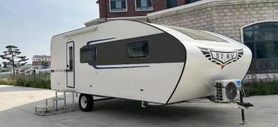
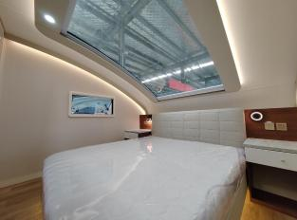
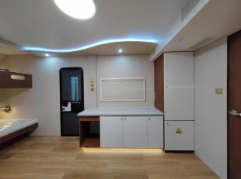
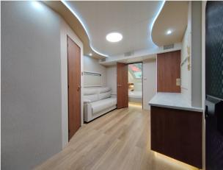
First / class / car Be / born / for / leading
First-class trailer-mounted barrier-9 meter Jane Love Parent-Child Starry Edition
Shan / dong / Shi / tuo / RV / Group / Co., / Ltd.

Slide 2
First / class / car Be / born / for / leading
First-class trailer-mounted barrier-9 meter Jane Love Parent-Child Starry Edition
9m Jane Ai Parent -Child Starry Sky Edition Configuration Table
Basic parameters | Basic configuration
Vehicle model | ST9890Y08-F1
physical dimension | 8380*3000*3150mm
Net size in the car | 7310*2930*2200mm
Interior space | 22 square meters
Number of bed shops | Big double bed+upper and lower shop single bed
Number of residents | 4
Vehicle equipment quality | About（3270kg）
Wheelbase | 5530mm
Number of a shafts | Single axle
Tire size | ST235/80 R16
Way of travel | Traction
Brake | none
Chassis | Galvanized steel pipe welded, rust -proof asphalt car paint
Furniture and interior configuration
Furniture | Walnut Simple Style
Carriage material | Composite Sician Tan Board
the color of car | White
Body decoration | UV -resistant ultraviolet special car sticker
Furniture | E0 solid wood multi -layer board
Furniture decorative stickers | PVC film panel, pattern
Mattress | Super soft print
floor | Brand floor
sofa | High -end leather sofa
Snursement upper and lower water road system configuration
bathroom | Wet and wet separation
Exhaust fan | Dedicated air -changing fan
sink | Square -shaped washbasin
shower head | Brand shower
Shower room | Rock board+UV board with glass sliding door
Toilet | Ceramic toilet
Method of upper and lower water | External pressure water source, direct discharge
Electrical configuration
Power supply | External 220V power supply
Electricity collection | Plug in card
Power distribution control cabinet | Steel spraying
Light | Indoor lighting 220V
Water heater | Brand constant temperature electricity storage water type 2000W/60L
air conditioner | Air conditioner 1.5P
refrigerator | Brand commercial refrigerator
Body accessory
Door | RV door
Access control system | Magnetic card+key
Window | RV special window
Sunroof | Ahead of the front big viewing sunroof
Sunshade | Early viewing Sky Window Electric Sun Shading Curse
Sunshade | 2.5 meters for RV feed sheds
Shan / dong / Shi / tuo / RV / Group / Co., / Ltd.

