Slide 1
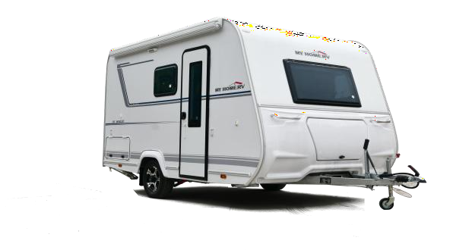
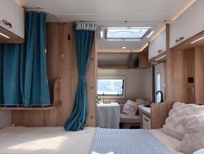
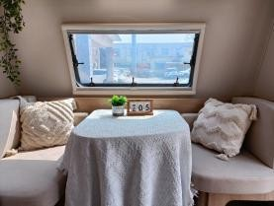
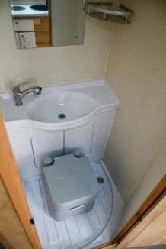
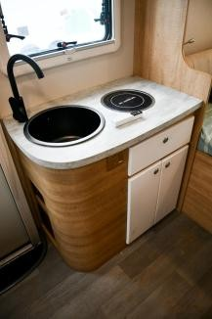
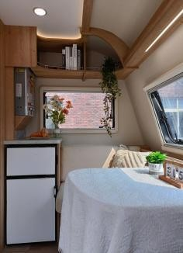
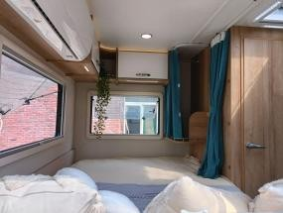
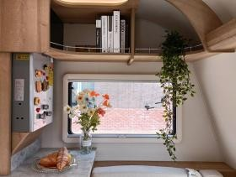
R520内外饰图
Sandu Ao New energy Trailer RV -5.2 meters couple version
三都澳新能源拖挂房车-5.2米情侣版
R520 interior and exterior decoration drawings

Slide 2
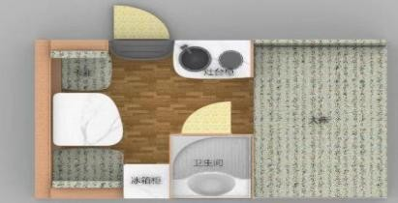
R520平面图及配置
Sandu ao new energy trailer RV -5.2 meters couple version configuration table
R520 Layout and configuration
三都澳新能源拖挂房车-5.2米情侣版配置表
Parameter | project | Standard version
Variable configuration | Two -way charging inverter integrated machine | 3000W
 | Solar MPPT controller 40A | •
 | Solar board 200W | •
 | Full -size spare tire | •
 | Collagen battery 12V100AH*2 | •
 | Suntech 3M*2M | •
 | Gas water heater | •
 | Fuel heater | •
 | 85L RV refrigerator | •
 | 220V inverter air conditioner | •
 | Portable toilet | •
Note • Standard O optional -there will be updates and upgrades in the later stage without this model. Do not notify separately. Please refer to the actual vehicle.
Parameter | project | Standard version
Basic parameters | Dimensions (long x wide x height) mm | 5247*2429*2590
 | Inner diameter size of the box (long x wide x height) mm | 3950*2210*1970
 | Number of residences | 3 people
 | Complete quality kg | 1200
 | Maximum load (KG) | 1400
 | Treatment head standard 50mm | •
 | Box sandwich structure | •
 | Chassic Aiko Shaft+Independent R & D Chassis | •
 | Brake system Aiko inertial collision brake+ hand brake
 | Shock absorption method Aiko shock absorber | •
 | Aluminum alloy wheel Tire specification 185/R14LT 8PR | •
Sanyu Ao R520 floor plan

Slide 3
R520平面图及配置
Sandu Ao New energy Trailer RV -5.2 meters couple version
R520 Layout and configuration
三都澳新能源拖挂房车-5.2米情侣版
Parameter | project | Standard version
Internal configuration | RV total control integrated panel | •
 | Bathroom assembly | •
 | Big double bed mm | 1450*2110
 | Sitting sofa (variable sofa bed) mm | 900*1920
 | Kitchen cabinet assembly | •
 | Refrigerator cabinet assembly | •
 | Kitchen cabinet | •
 | Bedside cabinet | •
 | Sofa cabinet | •
 | Super soft printing mattress | •
 | Bedside charging socket | •
 | 12V charging socket | •
 | Bedside shelf | •
 | Desktop high -power socket | •
 | Kitchen Cabinet high -power socket | •
 | Kitchen atmosphere light | •
 | Refrigerator cabinet high -power socket | •
 | LED indoor lighting | •
 | Smoke alarm | •
 | Carbon monoxide alarm | •
 | Gas alarm | •
 | Bedside reading light | •
 | Living room two -way air replacement fan | •
 | Sanitary dressing mirror | •
 | Bedside wardrobe | •
 | Bathroom cabinet in the bathroom | •
 | Two -way air replacement fan in the bathroom | •
 | Bathroom washing box | •
 | Pulling shower shower | •
 | Induction cooker 1200W | •
 | Nano -alloy laundry basin | •
 | Yahei Kitchen faucet | •
 | RV pump | •
 | Car special sheath line | •
 | Bathroom waterproof splash shower curtain | •
Parameter | project | Standard version
External configuration | Household | •
 | Anti -mosquito door | •
 | External LED waterproof ring photo lamp belt | •
 | Outdoor LED lighting | •
 | Outdoor tent track (double -sided) | •
 | ABS scratch predecessor | •
 | ABS scrape back circumference | •
 | Window outside the living room | •
 | Kitchen outside the window | •
 | Push a large window without ahead | •
 | Push the window outside | •
 | Pushing windows and mosquitoes | •
 | Obstically pushing window cover curtain | •
 | Silicone waterproof glue strip | •
 | External oversized storage warehouse | •
 | Built -in water water tank | 100L
 | Sewage tank | 70L
 | Urban plus water mouth with dedicated to connecting interface | •
 | Gravity plus Shuikou | •
 | External power port | •
 | External power cord | •
 | Parking Auxiliary Alloy Hands handle | •
 | ABS wheel eyebrow | •
 | Shaft head decoration cover | •
 | Shaft head decoration cover | •
 | Outdoor LED lighting | •
 | Solar panel beam, wiring box | •
 | Dedicated light alloy foot stool/pedal | •
 | Direction frame decorative cover | •

Slide 4
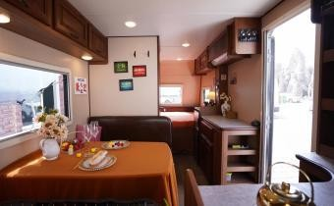
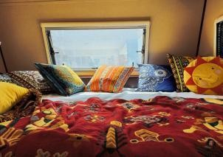
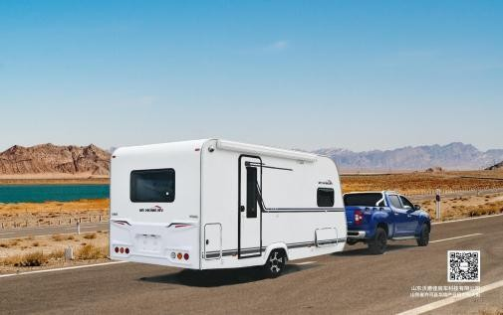
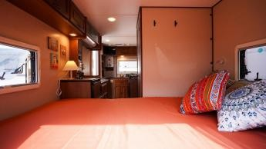
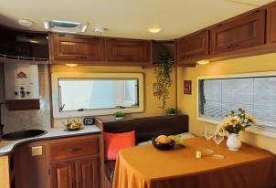
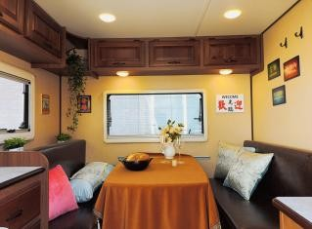
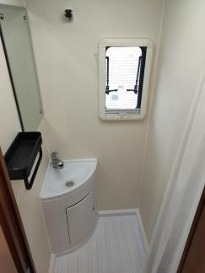
R590A内外饰图
Sandu New Energy Trailer RV -R590A American home version
R590A interior and exterior trim
三都澳新能源拖挂房车-R590A美式家庭版

Slide 5
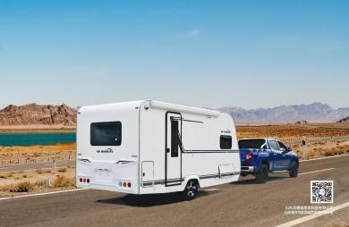
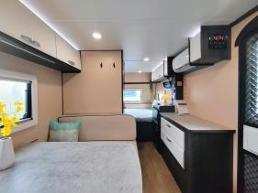
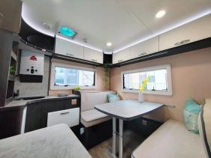
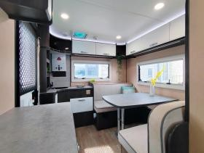
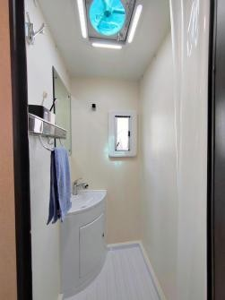
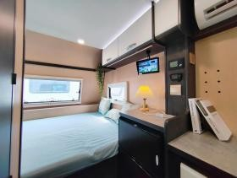
R590B内外饰图
Sandu ao New energy Trailer RV -R590B European home version
R590B interior and exterior decoration drawings
三都澳新能源拖挂房车-R590B欧式家庭版

Slide 6
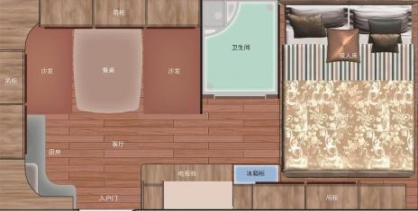
R590A/B平面图及配置
R590A/B Plane layout and configuration
Parameter | project | Exclusive edition W590A/B
4. Other and optional configurations | Suntech 3M*2M | •
 | External kitchen system | •
 | Gas water heater | •
 | Fuel heater | •
 | 220V inverter air conditioner | •
 | RV refrigerator 118L (refrigerated, freezing) | •
 | 3000W charging inverter all -in -one machine | •
 | Full -size spare tire | •
 | Portable toilet | •
 | Solar panel beam, wiring box | •
 | Solar MPPT controller 40A | •
 | Solar charging board 400W | •
 | Solar charging board 600W | o
 | Lithium battery 12v400Ah | •
 | Lithium battery 12v600Ah | o
Remarks 1. • standard O optional / unsatisfactory) 2. This model will be updated and upgraded in the future without notice. Please refer to the actual vehicle.
Parameter | project | Exclusive edition W590A/B
1. Basic parameters | Dimensions (long x wide x height) mm | 5995*2440*2590/2620
 | Box size (long x wide x height) mm | 4700*2210*1970
 | Number of residences | 4-5people
 | Complete quality (KG) | 1350
 | Maximum load (KG) | 1500
 | Treatment head standard 50mm | •
 | Box Sandwich structure | •
 | Aiko torque shaft | •
 | Car dedicated chassis (hot -dip galvanized treatment) | •
 | Brake system Aiko inertial collision brake+hand brake | •
 | Shock absorption method Shock absorber | •
 | European standard 13 stitch signal line Wire safety rope | •
 | Aluminum alloy wheel Tire specification 185/R14LT 8PR | •

Slide 7
R590A/B平面图及配置
Sandu ao New energy trailer RV - American family version
三都澳新能源拖挂房车-美式家庭版
R590A/B Plane layout and configuration
Parameter | project |  |  | Exclusive edition W590A/B
2. Internal configuration | Big double bed |  | mm | 1450*2110
 | The whole car imports lightweight board home furnishings |  |  | •
 | Bedside lamp |  |  | •
 | Super soft printing mattress |  |  | •
 | Built -in gas storage warehouse | 206L |  | •
 | Privacy split orbit |  |  | •
 | Bedside shelf |  |  | •
 | Refrigerator cabinet assembly |  |  | •
 | RV total control panel |  |  | •
 | Bathroom assembly |  | mm | 800*1000
 | Kitchen cabinet |  |  | •
 | Bedside cabinet |  |  | •
 | Plasma on the stuck bed cabinet |  |  | •
 | Smoke alarm |  |  | •
 | Carbon monoxide alarm |  |  | •
 | Gas alarm |  |  | •
 | Desktop high -power socket |  |  | •
 | Bedside charging socket |  |  | •
 | Kitchen Cabinet high -power socket |  |  | •
 | Refrigerator cabinet high -power socket |  |  | •
 | LED indoor lighting |  |  | •
 | LED atmosphere light |  |  | •
 | Sanitary dressing mirror |  |  | •
 | Bathroom cabinet in the bathroom |  |  | •
 | Both direction of the bathroom LED lighting fans |  |  | •
 | Bathroom washing box |  |  | •
 | Bathroom washbasin |  |  | •
 | Bathroom waterproof splash shower curtain |  |  | •
 | Playing stuck bed mm |  |  | 1200*1930
 | Living room two -way LED lighting air fan |  |  | •
 | Induction cooker 800W/1200W |  |  | •
 | Kitchen cabinet assembly |  |  | •
 | Yahei Kitchen faucet |  |  | •
 | Nano -alloy laundry basin |  |  | •
 | RV pump |  |  | •
 | Car special sheath line |  |  | •
Parameter | project | Exclusive edition W590A/B
3. External configuration | ABS scratch predecessor | •
 | ABS scrape back circumference | •
 | Water Cube Texture FRP (double -sided) | •
 | Parking Auxiliary Alloy Hands handle | •
 | Qianchang Qiida storage warehouse | •
 | External LED waterproof ring photo lamp belt | •
 | Outdoor LED lighting | •
 | Outdoor tent track (double -sided) | •
 | ABS wheel eyebrow | •
 | Shaft head decoration cover | •
 | Overbacco push front window | •
 | Super big pushing back windows | •
 | Super big push left window | •
 | Overbacco push right window | •
 | Household | •
 | Anti -mosquito door | •
 | Side super -large storage warehouse | •
 | Puritic water tank 100L | •
 | Sewage tank 70L | •
 | Urban plus water mouth with dedicated to connecting interface | •
 | Gravity plus Shuikou | •
 | External charging interface | •
 | Outer power cord bundle | •
 | Window to prevent mosquito curtains | •
 | Pushing the window | •
 | Silicone waterproof glue strip | •
 | Dedicated light alloy foot stool/pedal | •
 | Direction frame decorative cover | •

Slide 8
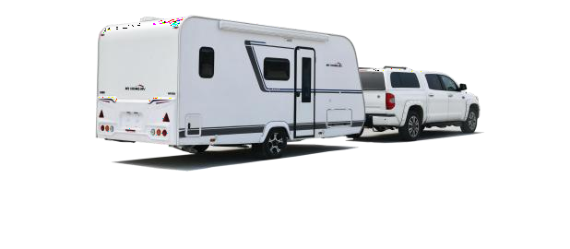
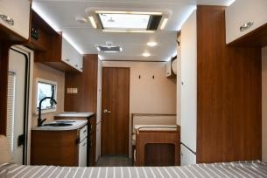
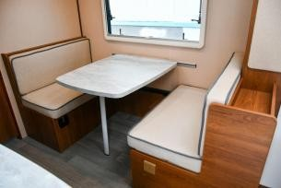
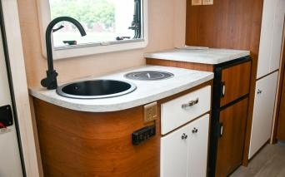
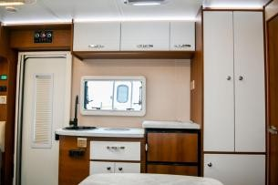
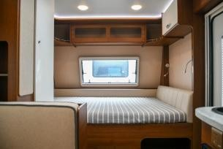
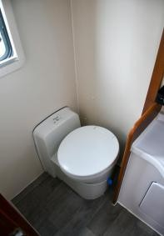
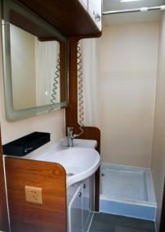
R650内外饰图
Sandu ao New energy trailer RV -R650 American home version
R650 interior and exterior trim drawings
三都澳新能源拖挂房车-R650美式家庭版

Slide 9
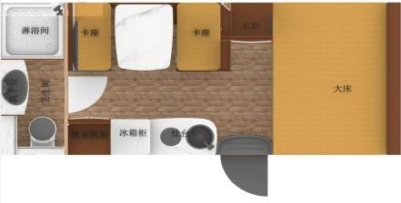
R650平面图及配置
R650 Floor plan and configuration
Sandu ao New energy trailer RV -R650 American home version
三都澳新能源拖挂房车-R650美式家庭版
Parameter | project | Exclusive edition
基本参数 | Dimensions (long x wide x height) mm | 6510*2440*2650
 | Inner diameter size of the box (long x wide x height) mm | 5200*2210*1970
 | Number of residences | 4-5people
 | Complete quality (KG) | 1450/1530
 | Maximum load (KG) | 1700
 | Treatment head standard 50MM | •
 | Box Sandwich structure | •
 | Aiko torque shaft | •
 | Car dedicated chassis (hot -dip galvanized treatment) | •
 | Brake system Aiko inertial collision brake+hand brake | •
 | Shock absorption method Aiko enhanced shock absorption damping | •
 | European standard 13 stitch signal line Wire safety rope | •
 | Aluminum alloy wheel Tire specification 205/75 R14C | •
Parameter | project | Exclusive edition
Other and optional configuration | Suntech3m*2m | •
 | Ceony warm wind, hot water all -in -one machine | •
 | 220V inverter air conditioner | •
 | RV refrigerator 118L (refrigerated, freezing | •
 | RV special washing machine (wave wheel) | •
 | 3000W charging inverter all -in -one machine | •
 | Full -size spare tire | •
 | Box toilet | •
 | Reverse image | •
 | Solar panel beam, wiring box | •
 | Solar MPPT controller 40A | •
 | Solar charging board 400W | o
 | Solar charging board 600W | •
 | Lithium battery 12v400Ah | o
 | Lithium battery 12v600Ah | •
Remarks 1. • standard O optional / unsatisfactory) 2. This model will be updated and upgraded in the future without notice. Please refer to the actual vehicle.

Slide 10
R650车辆配置
Sandu ao New energy trailer RV -R650 American home version
R650 vehicle configuration
三都澳新能源拖挂房车-R650美式家庭版
Parameter | project | Exclusive edition
Internal configuration | Big double bed mm | 1450*2110
 | The whole car imports lightweight board home furnishings | •
 | Bedside lamp | •
 | Super soft printing mattress | •
 | Privacy split orbit | •
 | Bedside shelf | •
 | Refrigerator cabinet assembly | •
 | RV total control panel | •
 | Independent shower | 800*800
 | Wet and wet separation toiletting room | •
 | Sanitary dressing mirror | •
 | Bedroom wardrobe | •
 | Living room wardrobe | •
 | Living room bookshelf | •
 | Kitchen cabinet | •
 | Bedside cabinet | •
 | Smoke alarm | •
 | Carbon monoxide alarm | •
 | Gas alarm | •
 | Plasma on the stuck bed cabinet | •
 | Desktop high -power socket | •
 | Bedside charging socket | •
 | Kitchen Cabinet high -power socket | •
 | Refrigerator cabinet high -power socket | •
 | LED indoor lighting | •
 | LED atmosphere light | •
 | Bathroom cabinet in the bathroom | •
 | Both direction of the bathroom LED lighting fans | •
 | Bathroom washbasin | •
 | Bathroom waterproof splash shower curtain | •
 | Playing stuck bed mm | 1000*1930
 | Living room oversized viewing sunroof | •
 | Living room two -way air replacement fan | •
 | Electromagnetic cooker 1200W five gear can be adjusted | •
 | Kitchen cabinet assembly | •
 | Yahei Kitchen faucet | •
 | Black nano -alloy laundry basin | •
 | RV brand water pump | •
 | Car special sheath line | •
Parameter | project | Exclusive edition
3. External configuration | ABS scratch predecessor | •
 | ABS scrape back circumference | •
 | Water Cube Texture FRP (double -sided) | •
 | Parking Auxiliary Alloy Hands handle | •
 | Qianchang Qiida storage warehouse | •
 | External LED waterproof ring photo lamp belt | •
 | Outdoor LED lighting | •
 | Outdoor tent track (double -sided) | •
 | ABS wheel eyebrow | •
 | Shaft head decoration cover | •
 | Super big push left window | •
 | Overbacco push front window | •
 | Household | •
 | Anti -mosquito door | •
 | Side super -large storage warehouse | •
 | Puritic water tank 100L | •
 | Sewage tank 70L | •
 | Urban plus water mouth with dedicated to connecting interface | •
 | Gravity plus Shuikou | •
 | External charging interface | •
 | Outer power cord bundle | •
 | Solar panel beam, wiring box | •
 | Window to prevent mosquito curtains | •
 | Pushing the window | •
 | Silicone waterproof glue strip | •
 | Dedicated light alloy foot stool/pedal | •
 | Direction frame decorative cover | •

Slide 11
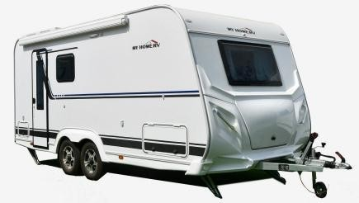
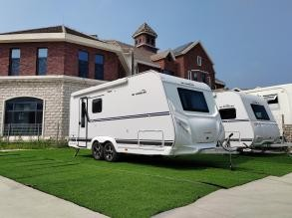
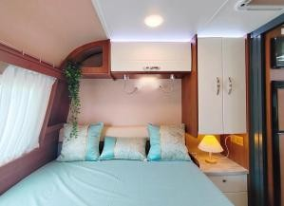
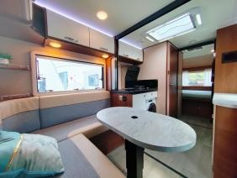
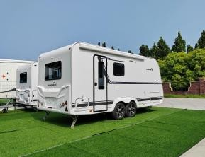
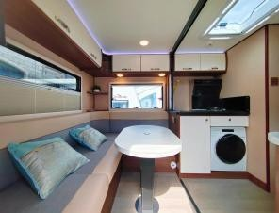
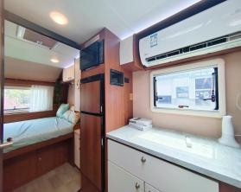
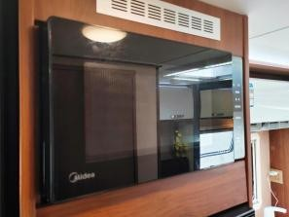
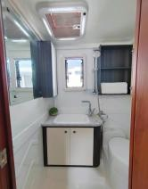
R670内外饰图
Sandu ao New energy Trailer RV -R670 American home version
R670 interior and exterior decoration drawings
三都澳新能源拖挂房车-R670美式家庭版

Slide 12
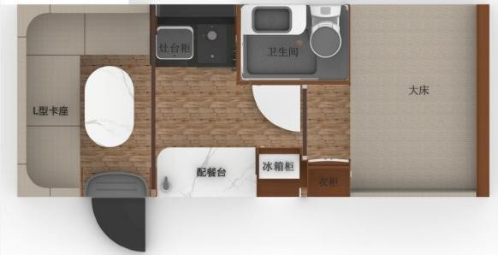
Parameter | project | Exclusive edition
Basic parameters | Dimensions (long x wide x height) mm | 6760*2305/2367*2610
 | Inner diameter size of the box (long x wide x height) mm | 5460*2140*1920
 | Number of residences | 4-6people
 | Complete quality (KG) | 1700
 | Maximum load (KG) | 1900
 | Treatment head standard 50MM | •
 | Box sandwich structure | •
 | Aiko Shuangqiao Torque Axis | •
 | Car dedicated chassis (hot -dip galvanized treatment) | •
 | Brake system Aiko inertial collision brake+hand brake | •
 | Shock absorption method Aiko enhanced shock absorption damping | •
 | European standard 13 stitch signal line Wire safety rope | •
 | Aluminum alloy wheel Tire specification 205/75 R14C | •
Other and optional configuration | Sunshade 3.5m*2.5m | •
 | Kitchen hot water treasure | •
 | Bedside USB converter | •
 | Storage warehouse shooting light | •
 | Niche induction night light | •
 | Bedroom atmosphere light | •
 | Bedroom folding curtain | •
 | Living room folding curtain | •
 | Electric rainfast of electric rain in the living room | •
 | Sewage tank 70L | •
 | Ceony warm wind, hot water all -in -one machine | •
 | Diesel oil storage assembly 30L fuel tank | •
 | 220V inverter air conditioner | •
 | RV refrigerator 138L (refrigerated, freezing) | •
 | RV special washing machine (drum) | •
 | RV microwave oven | •
 | 3000W charging inverter all -in -one machine | •
 | Full -size spare tire | •
 | Box toilet | •
 | surveillance system Wifi+reversing image | •
 | Dedicated light alloy foot stool/pedal | •
 | Electric water heater | •
 | Manually lifting legs | •
 | Electric lifting legs | o
 | Solar panel beam, wiring box | •
 | Solar MPPT controller 60A | •
 | Solar charging board 600W | •
 | Lithium battery 12v600Ah | •
 | RV device | o
 | Portable external kitchen | o
 | Portable external kitchen | o
 | Bottom powerful range hood | o
 | Gas stoves | o
Remarks 1. • standard O optional / unsatisfactory) 2. This model will be updated and upgraded in the future without notice. Please refer to the actual vehicle.
R670平面图及配置
R670 Floor plan and configuration
Sandu O R670 plan
三都澳R670平面图

Slide 13
R670车辆配置
Sandu ao New energy Trailer RV -R670 American home version
R670 vehicle configuration
三都澳新能源拖挂房车-R670美式家庭版
Parameter | project | Exclusive edition
External configuration | ABS scratch predecessor | •
 | ABS scrape back circumference | •
 | Direction frame decorative cover | •
 | Water Cube Texture FRP (double -sided) | •
 | Parking Auxiliary Alloy Hands handle | •
 | Qianchang Qiida storage warehouse | •
 | External LED waterproof ring photo lamp belt | •
 | Outdoor LED lighting | •
 | Outdoor tent track (double -sided) | •
 | ABS wheel eyebrow | •
 | Shaft head decoration cover | •
 | Super big push left window | •
 | Overbacco push front window | •
 | Household | •
 | Anti -mosquito door | •
 | Side super -large storage warehouse | •
 | Puritic water tank 100L | •
 | Urban plus water mouth with dedicated to connecting interface | •
 | Gravity plus Shuikou | •
 | External charging interface | •
 | Outer power cord bundle | •
 | Window to prevent mosquito curtains | •
 | Pushing the window | •
 | Silicone waterproof glue strip | •
Parameter | project | Exclusive edition
Internal configuration | Big double bed mm | 1400*2040
 | The whole car imports lightweight board home furnishings | •
 | Smoke alarm | •
 | Carbon monoxide alarm | •
 | Gas alarm | •
 | Bedside lamp | •
 | Super soft printing mattress | •
 | Bedside niche table | •
 | Bedroom hanging cabinet | •
 | Bedside wardrobe | •
 | Bedside storage drawer | •
 | Overall shower | 1200*850
 | Overall shower | •
 | Sanitary rack | •
 | The bathroom hanging clothes hook | •
 | Incorcetes in the bathroom | •
 | Bathroom sliding pole shower shower | •
 | Shower constant temperature valve | •
 | Kitchen cabinet | •
 | Stainless steel water basin assembly | •
 | Desktop high -power socket | •
 | Bedside charging socket | •
 | Kitchen Cabinet high -power socket | •
 | Refrigerator cabinet high -power socket | •
 | LED indoor lighting | •
 | LED atmosphere light | •
 | Sanitary dressing mirror | •
 | Both direction of the bathroom LED lighting fans | •
 | Bathroom washing box | •
 | Bathroom washbasin | •
 | Bathroom waterproof splash shower curtain | •
 | L -shaped sofa card bed mm | 1480*2040
 | Pneumatic free stop and lower table legs | •
 | Living room oversized viewing sunroof | •
 | Kitchen cabinet assembly | •
 | RV brand water pump | •
 | RV brand water pump | •

Slide 14
THANK
谢谢观看

